Slide 1

Wireless Networking
Ambuj Varshney
Assistant Professor, National University of Singapore
Wireless, Embedded Intelligence, Sensing, and Emerging Technologies Group
ambujv@nus.edu.sg

Slide 2
Administration and Course Logistics

Slide 3
Assignment 2
Link: https://weiserlab.github.io/ambuj/cs4222_assignment2
Deadline: 3rd of March 2023
Covers: 7% of overall grade
Program Sensor Tag, Implement State Machine, Using Actuators and Sensors
No Plagiarism! We will check for code similarity
No ChatGPT for this assignment
Submission: We will open link on Canvas
Notes:
++ We may all have heard of the term Internet of Things. So how are these wireless embedded systems related to the Internet of Things: Today, IoT includes a broad class of devices, including powerful platforms such as smartphones. However, it also includes more resource-constrained devices and what we call Wireless Embedded Systems, and in fact, I consider it to be one of the essential parts of the IoT ecosystem.
++ These are platforms equipped with a radio transceiver, sensor, microcontroller, and some form of energy storage. These platforms also often form a network, and sensor network as it is called has been an active area of research for the past two decades.
++ The research community has also developed wireless embedded platforms which we may know about, and these include: CMUCAM, which is an image sensor platform developed at Carnegie Mellon University, or Permamote is long life sensor platform from the lab I am associated with at UC Berkeley or Lorea which is a long-range backscatter platform that I had developed as part of my doctoral dissertation at Uppsala University. All of these are an example of Wireless Embedded Systems.

Slide 4
Tutorials
No tutorials this week!
Notes:
++ We may all have heard of the term Internet of Things. So how are these wireless embedded systems related to the Internet of Things: Today, IoT includes a broad class of devices, including powerful platforms such as smartphones. However, it also includes more resource-constrained devices and what we call Wireless Embedded Systems, and in fact, I consider it to be one of the essential parts of the IoT ecosystem.
++ These are platforms equipped with a radio transceiver, sensor, microcontroller, and some form of energy storage. These platforms also often form a network, and sensor network as it is called has been an active area of research for the past two decades.
++ The research community has also developed wireless embedded platforms which we may know about, and these include: CMUCAM, which is an image sensor platform developed at Carnegie Mellon University, or Permamote is long life sensor platform from the lab I am associated with at UC Berkeley or Lorea which is a long-range backscatter platform that I had developed as part of my doctoral dissertation at Uppsala University. All of these are an example of Wireless Embedded Systems.

Slide 5
Learning Objective for Today’s Lecture
Review: last few lecture’s topics
Communication layers
Medium access control
Random access protocol
Controlled access control
Channelization protocol
Spreading and coding
Case Study: LoRea

Slide 6
Review of Last Lecture

Slide 7
What is localization?
The goal of localization systems is to determine the physical coordinates of an electronic device such as IoT nodes, drones, mobile phones
These physical coordinates of electronic devices are:
Global - aligned with some externally meaningful systems like GPS
Relative - some “rigid transformation” (rotation, reflection, translation) away from a global coordinate systems

Slide 8
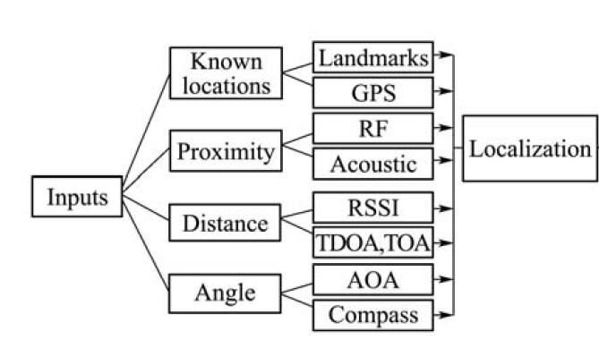
Overview of localization systems and modalities

Slide 9
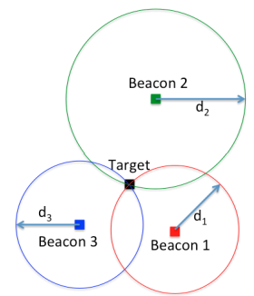
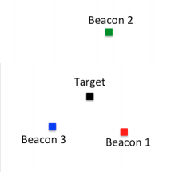
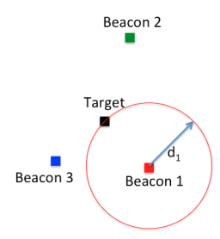
What is trilateration?
Determine distance from each beacon, then find position
Apply trigonometry to solve triangle with beacons.
Requires: 3 lengths (or some angles and lengths…)
Solve two triangles and get 3D position
Most common and accurate localization approach

Slide 10
How to determine distances?
Making trilateration work requires distance measurements
There are numerous techniques for distance measurement
RSSI (Received Signal Strength Indicator)
Time of Flight/ Time of Arrival
Time Distance of Arrival

Slide 11
Received Signal Strength Indicators (RSSI)
RSSI - received signal-strength indication
In theory, RSSI varies with 1/d^{α}
One common assumption, nodes that are closer have stronger RSSI than those further
In practice, RSSI ranging measurements contain noise on the order of several meters, highly non-uniform
Radio propagation differs over different surface (water, grass, asphalt etc.)
Obstacles such as wall, furniture etc.

Slide 12
Time of flight (also known as time of arrival, ToA)
Determine distance by knowing:
Exact position of infrastructure
Transmit time
Receive time
Signal velocity (i.e. speed of light)
Infrastructure transmits and device listens
Can happen all the time, but devices only listen when they want a position
Requires time synchronization between infrastructure and device
Synchronization must be good: 1 μs = 300 meters

Slide 13
Time of flight (also known as time of arrival, ToA)
Important Considerations:
Speed of signal propagation
Distance to be measured
Clock accuracy
Example:
Speed of light (c) ~ 3x10⁸ m/s
Distance travel in 1ms = 300m
Clock accuracy needed for meter accuracy (1/c) ~ 3ns
Speed of sound (v) ~ 330 m/s
Distance travel in 1ms = 0.33m
Clock accuracy needed for meter accuracy = 1/v ~ 3ms

Slide 14
Time difference of arrival (TDoA)
Device transmits and infrastructure receives transmission
Multiple infrastructure nodes receive at different times based on distance
Determine distance by knowing
Exact position of infrastructure
Time of arrival at two different locations
Signal velocity (i.e. speed of light)
Doesn’t require synchronization with infrastructure!
Still requires synchronization between infrastructure nodes
Does require device to transmit loud enough for infrastructure to hear it…

Slide 15
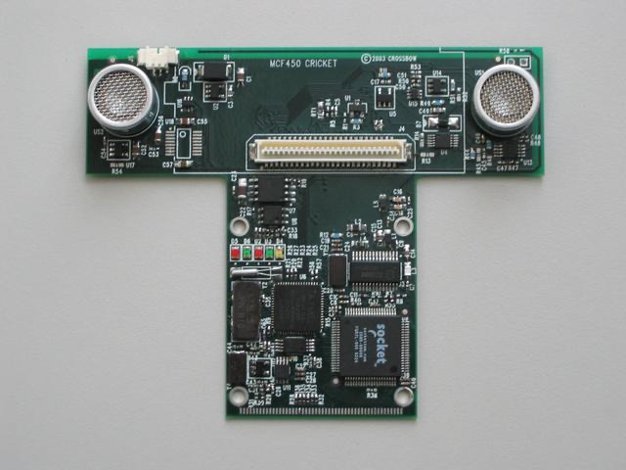
Time difference of arrival with different mediums
Exploit differences in speed, say RF and audio
Example: Cricket System [1]
In addition to a radio, each node also has a speaker and microphone
How does Cricket works?
Transmitter sends a radio message, waits some time (optionally) t_delay, sends audio “chirp” sound
Listener hears the radio signal, record time t_radio
Listener hears the audio signal, record time t_sound
[1] http://cricket.csail.mit.edu/

Slide 16
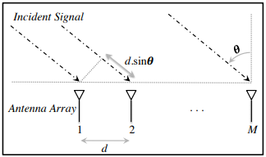
Angle of arrival (AoA)
Trilateration doesn’t only require distances, angles work
Antenna arrays can be used to determine the angle of an incoming signal
Allows the use of normal RF communication (WiFi or BLE)
BLE 5.1 includes AoA localization

Slide 17
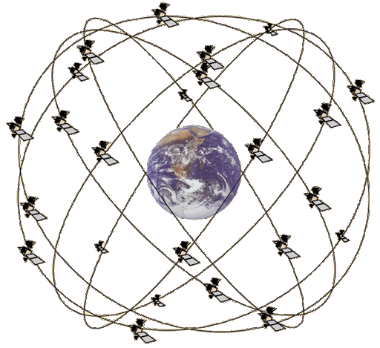
Overview of Global Positioning System
Trilateration using Time of Flight from at least 4 satellites
Satellites in well-known orbits with VERY stable clocks
Satellites placed in Medium Earth Orbit (20,000 KM)
Orbit earth twice per day
Placed such that 4 are in view everywhere, always
31 total in orbit as of November 2020
Most recent launch November 5th 2020
Comparisons
LEO 200-2000 km, ISS at 340 km
GEO 35,000 km

Slide 18
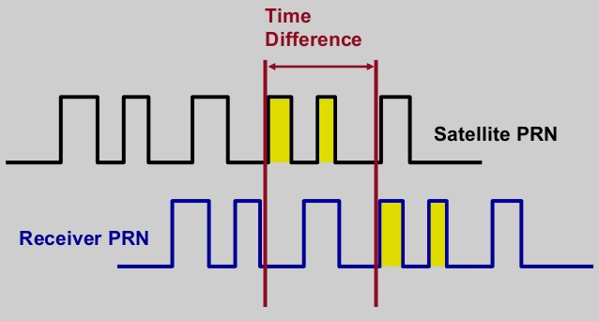
GPS transmissions
Each satellite sends a unique pseudo-random number sequence
Sequence repeats in time (over minutes) and is well-known
Position in signal is used to calculate time of flight

Slide 19
GPS requires signals from multiple satellites
4 satellites are needed to determine location and time
3 for 2D location (assume on ground) and 1 for time offset
Solve for both as a single equation
Steps to finding location
Initialize time to whatever you heard from a satellite (~100 ms sync)
Get time of arrival from four satellites
Four variables
x, y, z, and time offset

Slide 20
Mapping existing infrastructure
Can we repurpose existing infrastructure for localization?
For example: WiFi access points
Benefit: localization works with unmodified hardware
Mapping instead of trilateration
Make a map of infrastructure and use that to locate device
Coarse example: existence of WiFi network SSIDs
Fine-grained example: signal strength to each Access Point
Known as fingerprinting

Slide 21
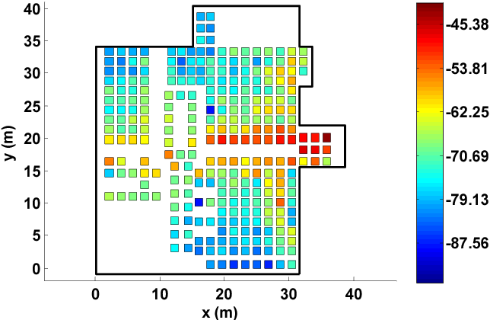
Fingerprinting overview
At setup time, for many locations throughout building
Measure signal strength to Access Point
Record measurement in a database with location
At run time, for the device that wants a location
Measure signal strength to Access Point
Look up measurement in database to get location

Slide 22
Fingerprinting challenges
Effort to create database in the first place
Manually take measurements at every location
Environment is not stable
Signal strength changes as chairs, doors, and people move
Need ability to periodically re-measure
Update database with most recent recording while in use
Measurements vary between devices
Differ based on antennas, cases, how you hold it, etc.

Slide 23
Improving accuracy
To get really good accuracy, let’s return to trilateration
Plan: Send an RF signal from one device and time how long it takes to reach another
Brief transmissions rather than continuous like GPS
Problem: When does this signal arrive?
Need to pick somewhere in rise as the “arrival time”

Slide 24
Multipath problem in wireless propogation
Real-world signals bounce off of things in the environment
Multiple, time-delayed versions of signal arrive at antenna
Result smears out the arrival of energy in time
More reflections mean more peak energy, but longer rise time
This isn’t predictable. Depends on the exact environment configuration

Slide 25
Ultra-wideband yield better localization performance?
Wider bandwidth makes the RF pulse narrower in time
Make it narrow enough, and multipath becomes entirely separate

Slide 26
Communication Layers

Slide 27
Communication layers
Application
Presentation
Session
Transport
Network
Data Link
Physical
What goes on at each of these?

Slide 28
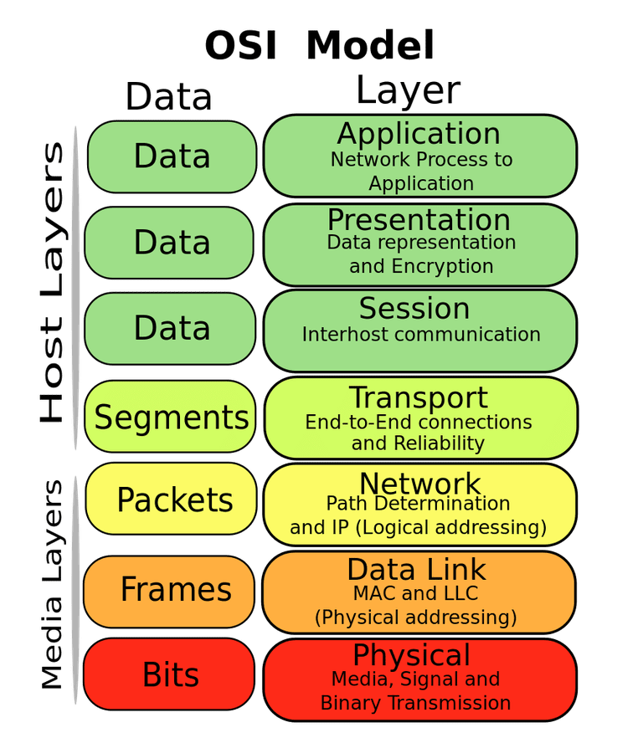
OSI model of communication layers
Transport
How to form connections between computers
TCP and UDP
Network
How to send packets between networks
IP
CS domain: CS340
Data Link
How to send frames of data
Ethernet, WiFi
Our focus
Physical
How to send individual bits
Ethernet, WiFi

Slide 29
Protocols are “layered”
Headers for each layer of communication wrap data
Data is wrapped with header for the network to make a packet
Packet is wrapped with header for the link to make a frame
Internet Packet
Data
Packet Header
Frame Header
Ethernet Frame

Slide 30
Transmitting data between networks
LAN1
Host A
Host B
LAN2
client
server
(1)
data
(8)
data
protocol
software
protocol
software
internet packet
(2)
data
PH
(7)
data
PH
LAN1
adapter
LAN2
adapter
LAN1 frame
Router
(3)
data
PH
FH1
(6)
data
PH
FH2
LAN1
adapter
LAN2
adapter
LAN2 frame
(4)
data
PH
FH1
data
PH
FH2
(5)
PH: Internet packet header
FH: LAN frame header
protocol
software

Slide 31
Data Link Layer
Framing
Combine arbitrary bits into a “packet” of data
Logical link control
Manage transfer between transmitter and receiver
Error detection and correction
Media access
Controlling which device gets to transmit next
Inherently coupled to PHY and its decisions

Slide 32
Framing
Typical packet structure
Preamble - Existence of packet and synchronization of clocks
Header - Addresses, Type, Length
Data - Payload plus higher layer headers (e.g. IP packet)
Trailer - Padding, CRC
Wireless considerations
Control information for Physical Layer
Ensure robustness for header
Explicit multi-hop routing
Possibly different data rates for different parts of packet
Preamble | Destination Address | Source Address | Type and Length | Data | CRC

Slide 33
Error control: detection and recovery
Detection: only detect errors
Make sure corrupted packets get discarded
Cyclical Redundancy Checks
Detect single bit errors
Detect “burst” errors of several contiguous bits
Recovery: also try to recover from small bit errors
Forward error correction
Retransmissions
Far more important for wireless because the cost of transmission is higher

Slide 34
Communication Layers

Slide 35
What is hard about wireless?
There are no wires!
Wired networks are constant, reliable, and physically isolated
Ethernet has the same throughput minute-to-minute
Bits sent through Ethernet or USB are (usually) received
Wireless networks are variable, error-prone, and shared
WiFi throughput changes based on location and walls
Signals from nearby devices interfere with your signals
Individual bits might flip or never be heard at all

Slide 36
Wireless is a shared medium
Wired communication has signals confined to a conductor
Copper or fiber
Guides energy to destination
Protects signal from interference
Wireless communication is inherently broadcast in nature
Energy is distributed in space
Signals must compete with other signals in same frequency band

Slide 37
Increasing network capacity is challenging
Wired networks just add more wires
Buses are many signals in parallel to send more data
Wireless networks are harder
Adding more links increases interference
Need to expand to different frequencies

Slide 38
Wired vs. Wireless
Key difference between wired and wireless is the need to support multiple access as wireless is broadcast in nature
How does a network determine which transmitter gets to transmit?
Remember: the wireless medium is inherently broadcast
Two simultaneous transmitters may lose both packets

Slide 39
Analogy: wireless medium as acoustic
How do we determine who gets to speak?
Two simultaneous speakers also lose both “transmissions”

Slide 40
Analogy: wireless medium as acoustic
How do we determine who gets to speak?
Two simultaneous speakers also lose both “transmissions”
Eye contact (or raise hand) -> out-of-band communication
Wait until it’s quiet for some time -> carrier sense multiple access
Strict turn order -> time division multiple access
Just speak and hope it works -> ALOHA
Everybody sing at different tones -> frequency division multiple access (stretching the metaphor)

Slide 41
Wireless: What are challenges of multiple access
Problem: Multiple radio transmitters want to access a common channel
How to coordinate access for these radio transmitters ?

Slide 42
What are mechanisms for multiple access
Mechanisms to support multiple access:
Avoid or reduce collisions
Detect collisions (less common in existing wireless MAC)
Decide when to retransmit

Slide 43
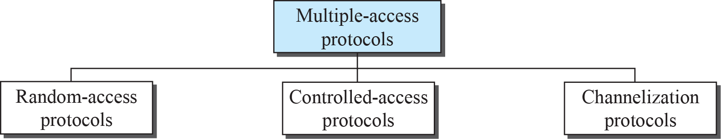
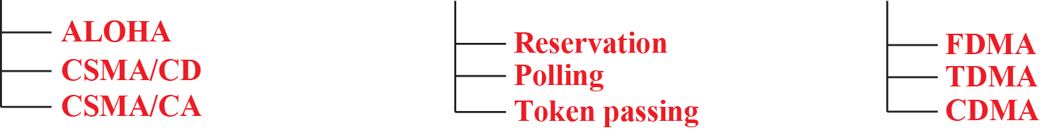
Review: Taxonomy of multiple-access protocols
Reduce collision,
“manage” retransmission
Avoid collision

Slide 44
Random Access Protocols

Slide 45
Random access medium access control protocols
No coordination
The simplest: ALOHA
When a node needs to send, it does so.
If it hears an acknowledgment within a given duration, transmission is successful
otherwise, it resends after waiting a random amount of time.
Protocol strength
minimum overhear
achieves low delay if the load is light

Slide 46
ALOHA
ALOHAnet (1971)
University of Hawaii – Norman Abramson
First demonstration of wireless packet network
Rules
If you have data to send, send it
Two (or more) simultaneous transmissions will collide and be lost
Wait a duration of time for an acknowledgement
If transmission was lost, try sending again “later”
Want some kind of exponential backoff scheme here

Slide 47
Packet collisions
Each packet transmission has a window of vulnerability
Twice the on-air duration of a packet
Transmissions during the packet are bad
Transmissions before packet can also be bad

Slide 48
Slotted ALOHA
Split time into synchronized “slots”
Any device can transmit whenever it has data
But it must transmit at the start of a slot
And its transmission cannot be longer than a slot
Removes half of the possibilities for collisions!
At the cost of some synchronization method
time

Slide 49
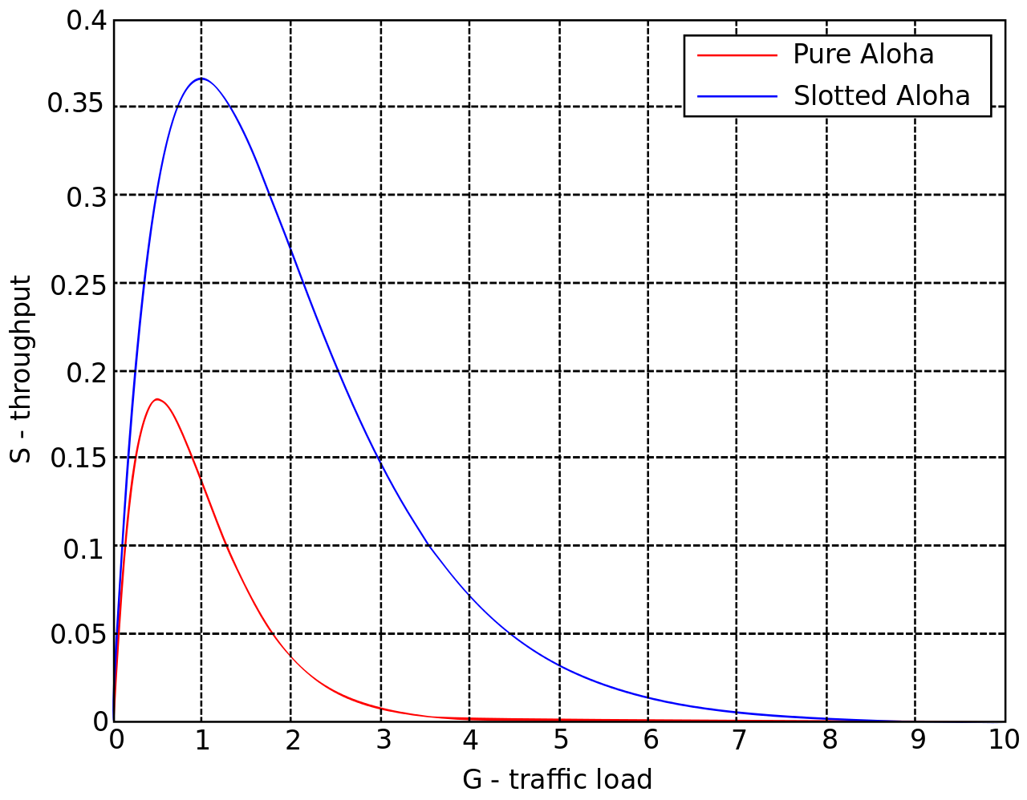
ALOHA throughput
It can be shown that traffic maxes out at
ALOHA: 18.4%
Slotted ALOHA: 36.8%
Assuming Poisson distribution of transmission attempts
Slotted throughput is double because the “before” collisions can no longer occur

Slide 50
Carrier Sense Multiple Access
Carrier Sense Multiple Access:
sense carrier
If idle,
send
wait for ack
If there isn’t one, assume there was a collision, retransmit
Should we transmit immediately once channel is idle?

Slide 51
CSMA/CD – CSMA with Collision Detection
Detect collisions during your own transmission
Works great on wired mediums (Ethernet, I2C)
Somewhere between challenging and impossible for wireless
Transmit and receive are usually the same antenna
Receiving while transmitting would be drowned out by transmission
Remember: TX at 8 dBm and RX at -95 dBm

Slide 52
Carrier Sense Multiple Access/ Collision Avoidance
CA – Collision Avoidance
if the channel is clear, deferred transmission for a "random" interval
Choose interval from a uniform distribution with values between 0 and maximum window size W_{max}
reduces the probability of collisions on the channel
How large should W_{max} be?
If interval is long, time is “wasted” …
If interval is too short?

Slide 53
CSMA/CA: Choosing W_{max}
Should W_{max} be constant?
Intuitively, W_{max} should be small when there is lower chance of collision and vice versa
W_{max} varies according to the Binary Exponential Backoff (BEB) algorithm.
Set “slot time” to 2 times the max. propagation delay on the channel
If this is the first transmission, sends immediately
If there is a collision, after i-th collision, pick W_{max} randomly between 0 and 2^{i}-1 time slots.

Slide 54
CSMA/CA: Exponential Backoff Algorithm
W_{max} is usually capped at some maximum value, e.g. 2¹⁰ – 1 or 1023
What is the rationale behind BEB?
Is it a fair way to share the channel?
Over the “long term”, nodes send (almost) same number of packets

Slide 55
CSMA/CA: Trade-off
What are the Trade-off:
More aggressive (smaller W_{max}) – more likely to achieve higher channel utilization, but also more likely to collide
Less aggressive – lower channel utilization, less likely to collide
Utilization vs. delay
Overly aggressive or conservative can increase delay
Optimal point depends on
Number of stations/nodes contenting
Traffic load

Slide 56
Window Size “Tuning”
W_{max} window can be varied to change the share of the bandwidth that are allocated to various mobile nodes
Main idea: station/node with “smaller” W_{max} gets larger share of bandwidth
Problem: find the “right” combinations of window sizes for different nodes

Slide 57
Sharing/Allocation “Problems”:
Hidden Terminal
Rate Asymmetry
Capture Effect

Slide 58
Hidden terminal problem
Device C
Device A
Device B

Slide 59
CSMA with RTS/CTS
Hidden terminal problem means that two transmitters might never be able to detect each other’s transmissions
A partial solution
When channel is idle, transmitter sends a short Request To Send (RTS)
Receiver will send a Clear To Send (CTS) to only one node at a time
RTS collisions are faster and less wasteful than hidden terminal collisions
Downside: overhead is high for waiting for CTS when contention is low

Slide 60
Solving Hidden Terminal Problem
Should RTS/CTS be used all the time?
B
RTS
CTS
CTS
A
C
OK, I’ll wait …

Slide 61
But Expose Terminal Problem…
B
CTS
RTS
RTS
A
C
C wants to transmit, OK?
D

Slide 62
Wireless channel quality and transmission rate
Wireless transmission rate achievable depends on
channel quality: higher rate on “good” channel
technology used:
802.11b (1 – 11Mbps)
802.11a/g (6 – 54Mbps)
802.11n (7.2 – 150Mbps)
Common for an WiFi access point to support devices with different channel qualities and 802.11 protocols
What is the impact of such heterogeneity on average transmission rate?

Slide 63
Wireless channel quality and transmission rate
Average transmission rate
= Number of packets sent in X secs / X secs
In standard CSMA/CA, nodes send (almost) same number of packets on the average
Configuration
number of nodes: X (>1)
two rates: 10Mbps or 150Mbps

Slide 64
Wireless channel quality and transmission rate
X-1 nodes at 150Mbps, 1 node at 10Mbps
Each node sends same number of packets
Let time unit be duration to transmit one packet at 10Mbps
Number of packets sent (by X nodes) = X
Duration to send X packets = (X-1)/15 + 1
Average rate = 10 * X / ((X-1)/15 + 1) = 150X/(X+14)
X=2, rate = 300/16 = 18.75
X=5, rate = 750/19 = 39.47
X=10, rate = 1500/24 = 62.5

Slide 65
Wireless channel quality and transmission rate
With current CSMA/CA MAC, average rate drops significant when devices use very different rates
System is fair, but efficiency is low
One can achieve better balance of fairness and efficiency if a different notion of fairness is used
Another notion of fairness: each node allocated same transmission duration

Slide 66
Wireless channel quality and transmission rate
Configuration
number of nodes: X (>1)
two rates: 10Mbps or 150Mbps
X-1 nodes at 150Mbps, 1 node at 10Mbps
Duration = X
Number of packets sent = 15(X – 1) + 1
Average rate = 10 * (15(X – 1) + 1) / X = 150 – 140/X
X=2, rate = 150 - 70 = 80
X=5, rate = 150 – 28 = 122
X=10, rate = 150 – 14 = 136

Slide 67
Receiving transmissions with collisions
Collision does not always lead to packet loss
If a receiver hears from two or more stations and the signal from one station is much stronger than the rest, the receiver can receive the signal correctly “only” from this station: This is called capture effect.

Slide 68
Receiving transmissions with collisions
One receiver, multiple transmitters (transmit same packet)
With capture effect, adding new transmitters may improve reliability!

Slide 69
Receiving transmissions with collisions
99%
15%
35%
100%
R
-70.89dB
T4
-80.93dB
-83.02dB
-84.09dB
T3
T2
T1

Slide 70
Capture Effect and Antennas
Notes:
Begin by talking about contributions made with directional antennas to allow co-existence on shared spectrum for battery operated NES
This work was done in the firs two and half years of my PhD studies

Slide 71
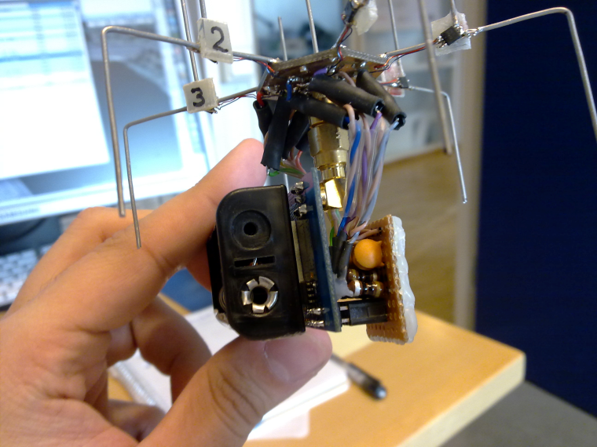
Directional Antenna for Sensing and Communication
What is a directional antenna?
Studied extensively in 1-hop networks, e.g., WiFi networks
ESD antennas are feasible, simple and inexpensive
SPIDA [1,2] - 6 configurable directions, costs < 5 USD
Power consumption of few microwatts!
[1] Erik Ostrom et al. "Evaluation of an electronically switched directional antenna for real-world low-power wireless networks” – REALWSN 2010
[2] Martin Nilsson. “Directional antennas for wireless sensor networks” - 9th Scandinavian Workshop on Wireless Adhoc Networks 2009
Notes:
- Talk about what is directional antenna
A Directional antenna radiates or receives greater power in specific directions.
An ESD or Electronically Steerable Directional antennas is a type of diretional antena that allows the electronic control of the direction of maximum antenna gain. One example of ESD antenna is the SPIDA which you can see in the slide. These antennas are feasble, simple and inexpensive. E.g., the SPIDA antenna you see on the slide can be configured to six possible antenna direction and costs only 5 USD to make.
Despite advantages offered by ESD antennas, they have not been widely used for NES. The protocols and insights from other wireless networks cannot be applied to NES as they are usually multihop in nature, and they present very different challenge as compared to 1-hop networks.
One of the reasons was lack of testbed to perform experiments with ESD antenna. Initial part of my phd studies looked at designing testbed of WSN nodes equipped with the SPIDA antenna.
Next we discuss two sensing and communication application we explored with the ESD antenna.

Slide 72
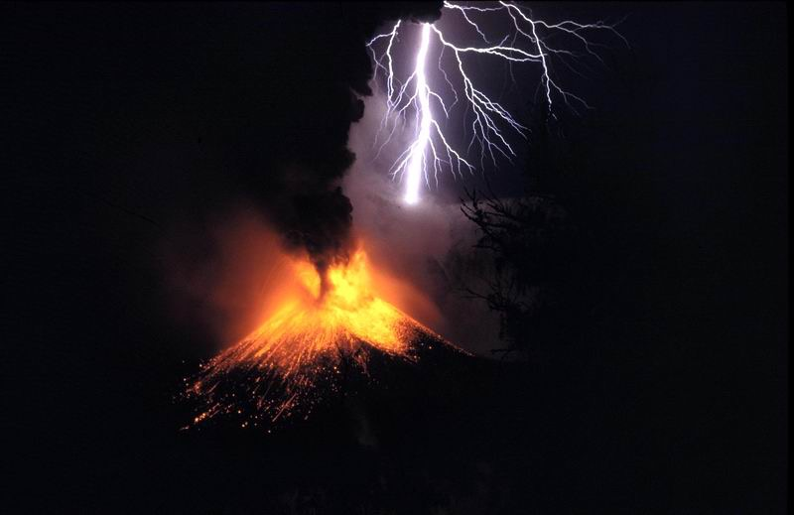
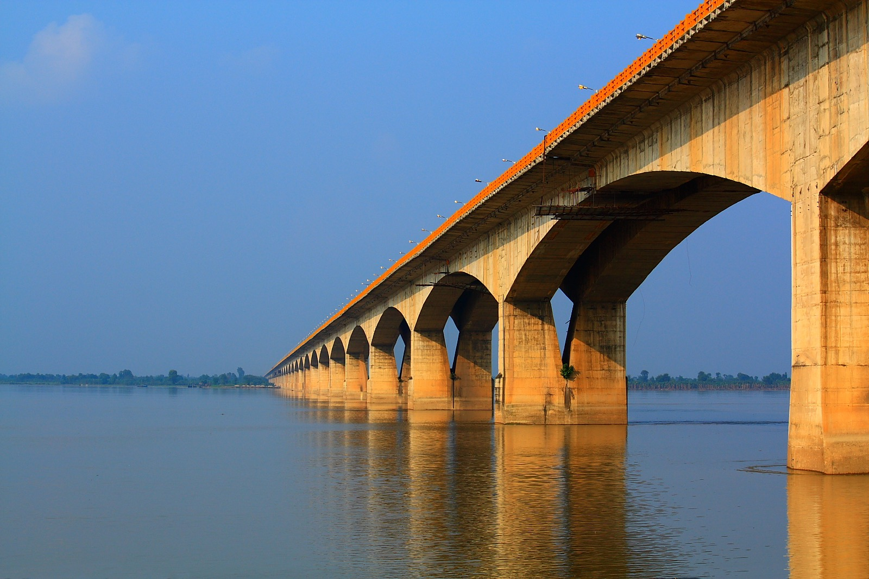
Bulk Data Transmissions
Traffic pattern of many WSN applications
Volcano monitoring [1]
Bridge monitoring [2]
Directional antenna beneficial for such applications
Increased communication range at no additional energy cost
Bulk transmission(s) most severely affected by interference
[1] Geoff Werner-Allen et al. "Fidelity and yield in a volcano monitoring sensor network” in OSDI 2016
[2] Kameswari Chebrolu et al. "Brimon: a sensor network system for railway bridge monitoring” in ACM MOBISYS 2008
Notes:
Bulk data is traffic pattern for many WSN applications, including for example volcano monitoring or structural health monitoring. The central feature of these applications is that there is large amount of sensed data that is collected and send over multi-hop low-powered wireless links to a powerful sink node for further processing. The directional antennas are beneficial for such applications as they increase the communication range at no additional energy cost, also bulk transmissions as they occupy channel for larger period of time are more severely affected by interference. However, in WSN there are no existing protocol to exploit this.

Slide 73
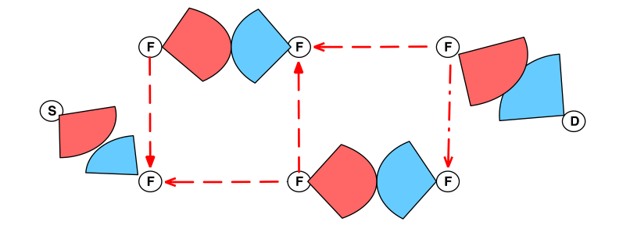
DPT’s Contributions
Directional Pipelined Transmissions (DPT)
Leverage directional transmissions and receptions
Reduce inter/intra path interference using directional communication
Highest reported throughput in 802.15.4 multi-hop links
Operation on single wireless channel
DPT creates two pipelines between source and sink
All nodes are always active!
Ambuj Varshney, Luca Mottola, Mats Carlsson, and Thiemo Voigt. 2015. Directional Transmissions and Receptions for High-throughput Bulk Forwarding in Wireless Sensor Networks. In Proceedings of the 13th ACM Conference on Embedded Networked Sensor Systems (SenSys '15).
Notes:
So our main contribution in this work is we present a protocol called DPT which leverages directional transmissions and receptions. We demonstrate that directional communication can reduce intra/inter path interference signficiantly. We further demontsrate that this reduced interapath and interpath interference allows high throughput multihop transmissions to occur on one wireless channel. We also achieve the highest reported throughput in 802.15.4 multihop links.

Slide 74
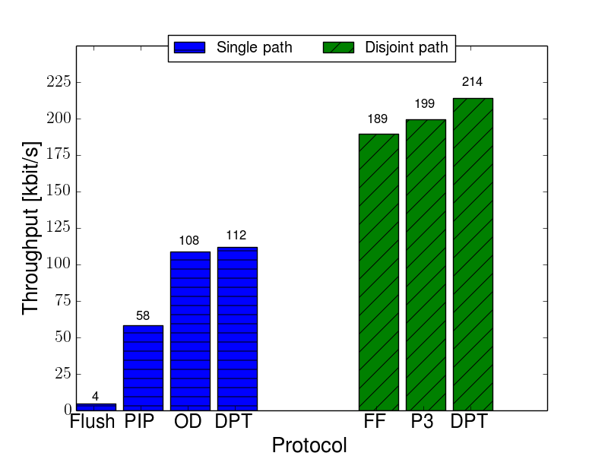
DPT Throughput Comparison
Existing protocols not designed for ESD antennas
State-of-the-art:
P3 [1] multiple channels ,higher node density
[1] Manjunath Doddavenkatappa et al. "P 3: a practical packet pipeline using synchronous transmissions for wireless sensor networks.” in ACM/IEEE IPSN 2014
Notes:
We compare the performance of DPT to the state of the art in bulk forwarding in WSN. Since these existing protocols were not designed for ESD antennas, we do not experimentally compare DPT with thesse protocols. We compare the performance of DPT with the highest reported throughput from their respective publications. As we see on the figure on the screen, DPT out performs all of the protocol in terms of highest throughput achieved for both single path and disjoint path. P3 is closest in terms of performance to DPT, however, unlike P3 we use only one wireless channel for bulk data transmission.

Slide 75
Controlled Access Control

Slide 76
Review: Taxonomy of multiple-access protocols
In controlled access, the stations consult one another to find which station has the right to send. A station cannot send unless it has been authorized by other stations.

Slide 77
Medium access control: Controlled Access
How do you control who has access to medium?
Reservation
Polling
Token Passing

Slide 78
Medium access control: Reservation access method
A station needs to make a reservation before sending data
Example:
time is divided into reservation and data slots
reservation frame precedes the data frames sent
System is more efficient if many data frames are sent after one reservation
Reservation Contention Slots
Data Slot
Reservation Contention Slots
Data Slots

Slide 79


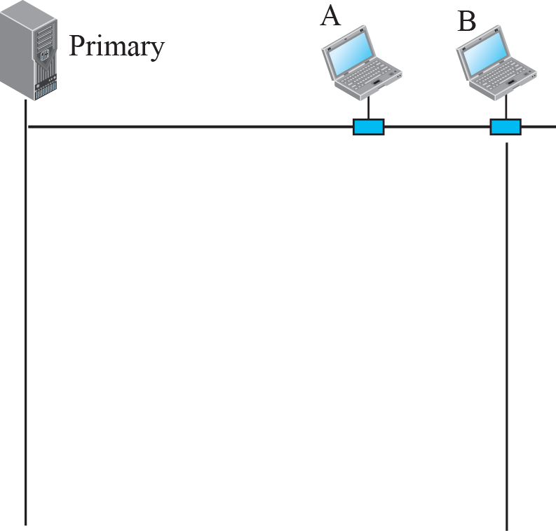
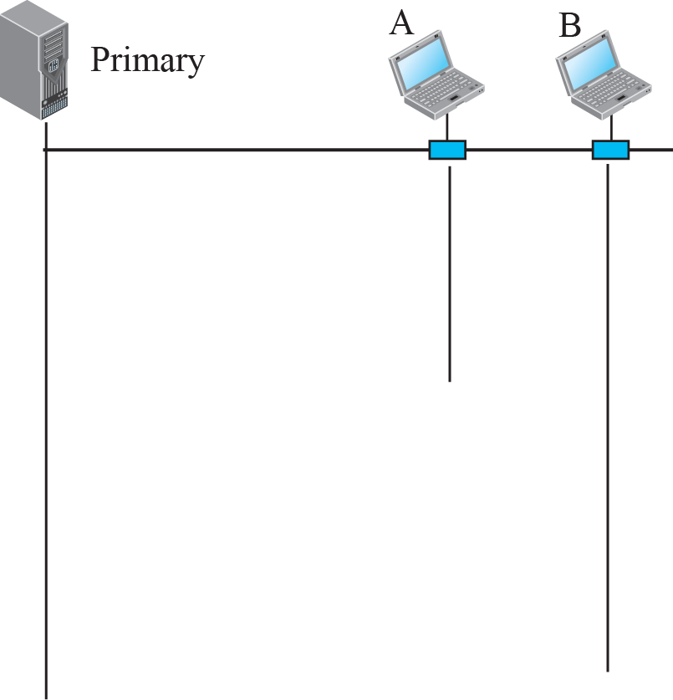
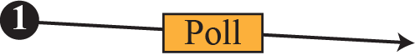
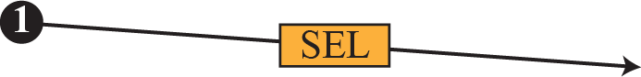
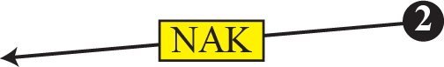
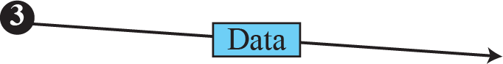
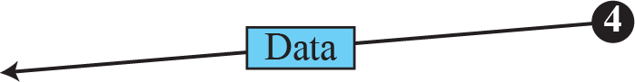
Medium access control: Polling
One primary and many secondary stations
Select: primary station sends to a secondary station
Poll: primary station ask if a secondary station has data to send

Slide 80
Medium access control: Polling
Polling is defined in the IEEE 802.11 standard as the Point coordination function (PCF)
Access Point (AP) polls the wireless stations to check for transmission requests
This mode is designed to support interactive traffic, e.g. VoIP
There is no collision since channel access is controlled by a central controller

Slide 81
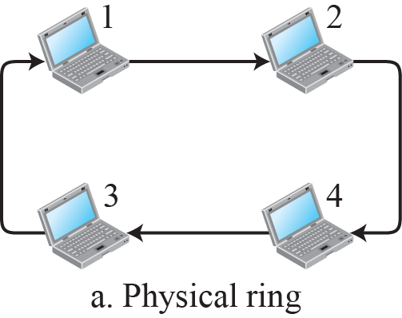
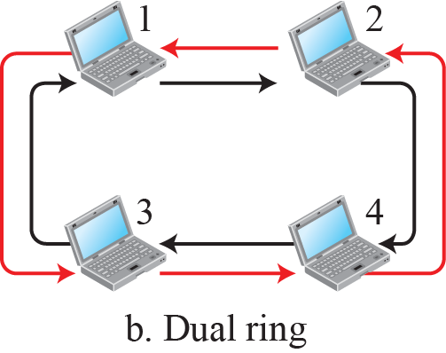
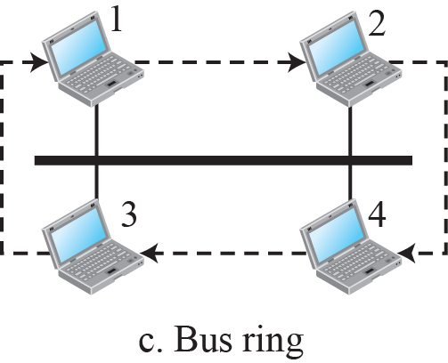
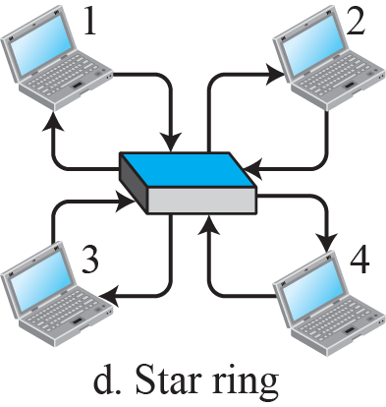
Medium access control: Token Passing

Slide 82
Channelization Protocols

Slide 83
Taxonomy of multiple-access protocols
“static” allocation of resources

Slide 84
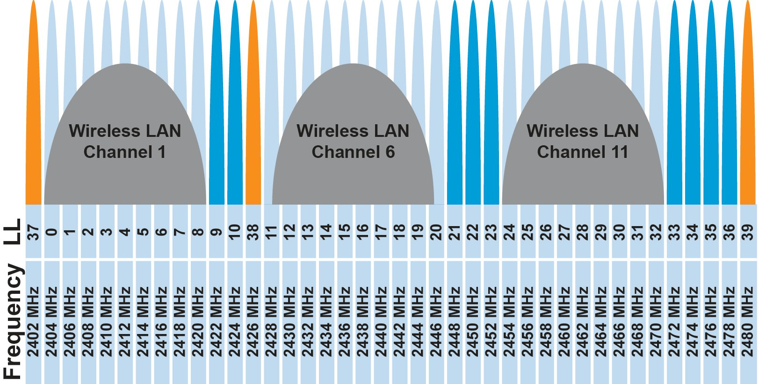
FDMA – Frequency Division Multiple Access
Split transmissions in frequency
Different carrier frequencies are independent
Fundamentally how RF spectrum is split
Technically, each device uses a separate, fixed frequency
Walkie-talkies
Conceptually, how RF channels work
WiFi networks pick different bands
802.15.4 picks a channel to communicate on

Slide 85
TDMA – Time Division Multiple Access
Split transmissions in time
Devices share the same channel
Splits time into fixed-length windows
Each device is assigned one or more windows
Can build a priority system here with uneven split among devices
Requires synchronization between devices
Often devices must listen periodically to resynchronize
Less efficient use of slots reduce synchronization
Large guard windows. E.g. 1.5 second slot for a 1 second transmission

Slide 86
TDMA: Time Division Multiple Access‏
Consider a 1Mbps channel (1,000,000bits/sec)
Divide channel into 1000 (equal) times slots
Each slot is 1ms, and can transmit 1,000 bits
Assign slots to 50 users
Each user transmits every 50 slots/ms and transmit 20 times/slots per second
On average, each user can transmit 20kbps
Buffering is needed on both sender and receiver to match the differences in data rates
sender-side: 20kbps -> 1 Mbps
Receiver-side: 1Mbps -> 20kbps
Notes:
86
86

Slide 87
TDMA Buffering (1kbps -> 5kbps)
1kbps over 1ms, every 5ms
5kbps over 1ms, every 5ms

Slide 88
TDMA vs. FDMA
FDMA
TDMA
Frequency
Frequency
Time
Time
In practical systems, TDMA is often combined with FDMA
Frequency
Time
Notes:
88
88

Slide 89
Other Examples
Sharing of channel when there is two way communications (duplex)
FDD: Frequency Division Duplex
Different frequencies used for downlink and uplink
Cellular systems: AMPS, NA-TDMA, CDMA, GSM
TDD: Time Division Duplex
Cordless telephone systems: CT2, DECT, PHS
Notes:
89
89

Slide 90
Pros/Cons of “Static” Allocation
Pros:
Resource is always available, performance guarantee
No interference from other users
Cons:
Inefficient if resource is not utilized. Resource cannot be used by other users
Slow to adjust to traffic demand changes

Slide 91
Orthogonal Frequency Division Multiplexing :OFDM
In FDM, the entire frequency spectrum is dedicated to carry data from a single source
Example: transmit at 40Mbps over a 20 MHz spectrum
In OFDM, data is divided into many (slower) bit streams and multiple subcarriers (each with smaller spectrum) is used
Example: divide data source into 40 sources, each 1Mbps

Slide 92
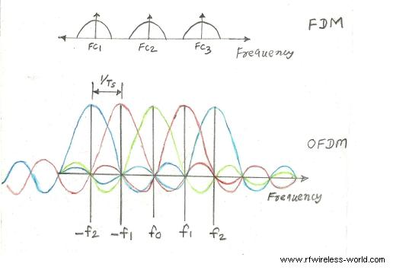
OFDM vs FDM
http://www.rfwireless-world.com/Articles/difference-between-FDM-and-OFDM.html

Slide 94
What are benefits of OFDM
Robust to selective fading
Overcomes inter-symbol interference in a multi-path environment because data rate per subcarrier is lower
Applications:
IEEE 802.11a, g, n and ac
LTE/5G
Digital radio and TV broadcast

Slide 95
Spreading and Coding

Slide 96
Code division multiple access: CDMA
CDMA – code division multiple access
A multiplexing technique use with spread spectrum
An analogy: Many people wish to communicate with each other in a room. To avoid confusion, people could
TDMA: take turns speaking (time division)
FDMA: speak at different pitches (frequency division),
CDMA: speak in different languages (code division)

Slide 97
Spread Spectrum (SS)
Spread-spectrum techniques are methods by which a signal is deliberately spread in the frequency domain, resulting in a signal with a wider bandwidth
Such techniques can be used to establish secure communications, increase resistance to natural interference, jamming and to prevent detection
Concept has been alluded to in 1900s, and applied in some form during WWII

Slide 98
Spectrum of Combined Signal
Resistant to narrowband interference
Signals are difficult to interpret – appears as if increase in background noise
Can share frequency band with others with minimal interference

Slide 99
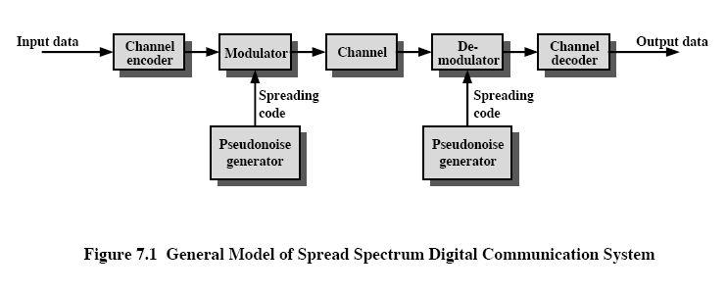
General Model

Slide 100
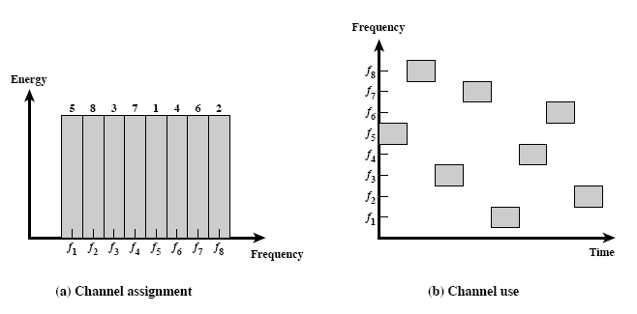
Frequency Hopping (FH)
How does FHSS increase resistance to
natural interference
jamming
detection

Slide 101
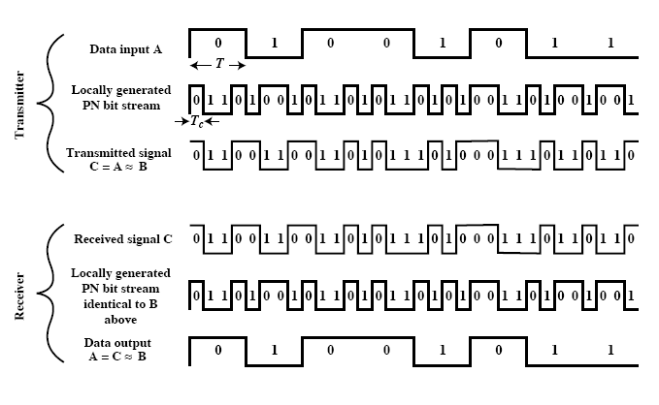
Direct Sequence (DS)

Slide 102
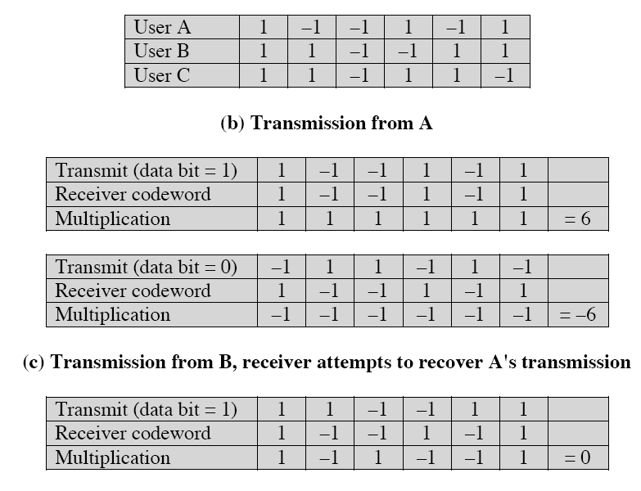

Slide 103
Code Design
2 categories: synchronous (orthogonal codes) and asynchronous (pseudorandom codes)
Synchronous CDMA use when sending from BS to mobile
Synchronous CDMA exploits mathematical properties of orthogonality between vectors representing the data strings. When the dot products of vectors is zero, the two vectors are said to be orthogonal to each other
Example: Walsh codes obtained from Walsh matrix

Slide 104
Code Design (cont’d)
Asynchronous CDMA use when sending from mobile to BS
the different mobile-to-base links cannot be precisely coordinated
as it is not mathematically possible to create signature sequences that are orthogonal for arbitrarily random starting points, unique "pseudo-random" or "pseudo-noise" (PN) sequences are used
Correlation property: if a period of the sequence is compared term by term with any shift, the number of terms that are the same differs from those that are different by at most 1

Slide 105
Real-world protocol access control
ALOHA
BLE advertisements
Unlicensed LPWANs: Sigfox, LoRaWAN
CSMA
WiFi (slotted, CSMA/CA)
TDMA
BLE connections
Cellular LPWANs: LTE-M and NB-IoT

Slide 106
Use of CDMA/DSS
Cellular
2G CDMA (IS-95)
3G networks
802.11
1997: original version of the standard IEEE 802.11 operates at 1 or 2 Mbps and uses FHSS or DSSS, running at 2.GHz
1999: 802.11b, 2.4GHz, DSSS/CCK at 5.5 and 11Mbps

Slide 107
Case study: LoRea

Slide 108
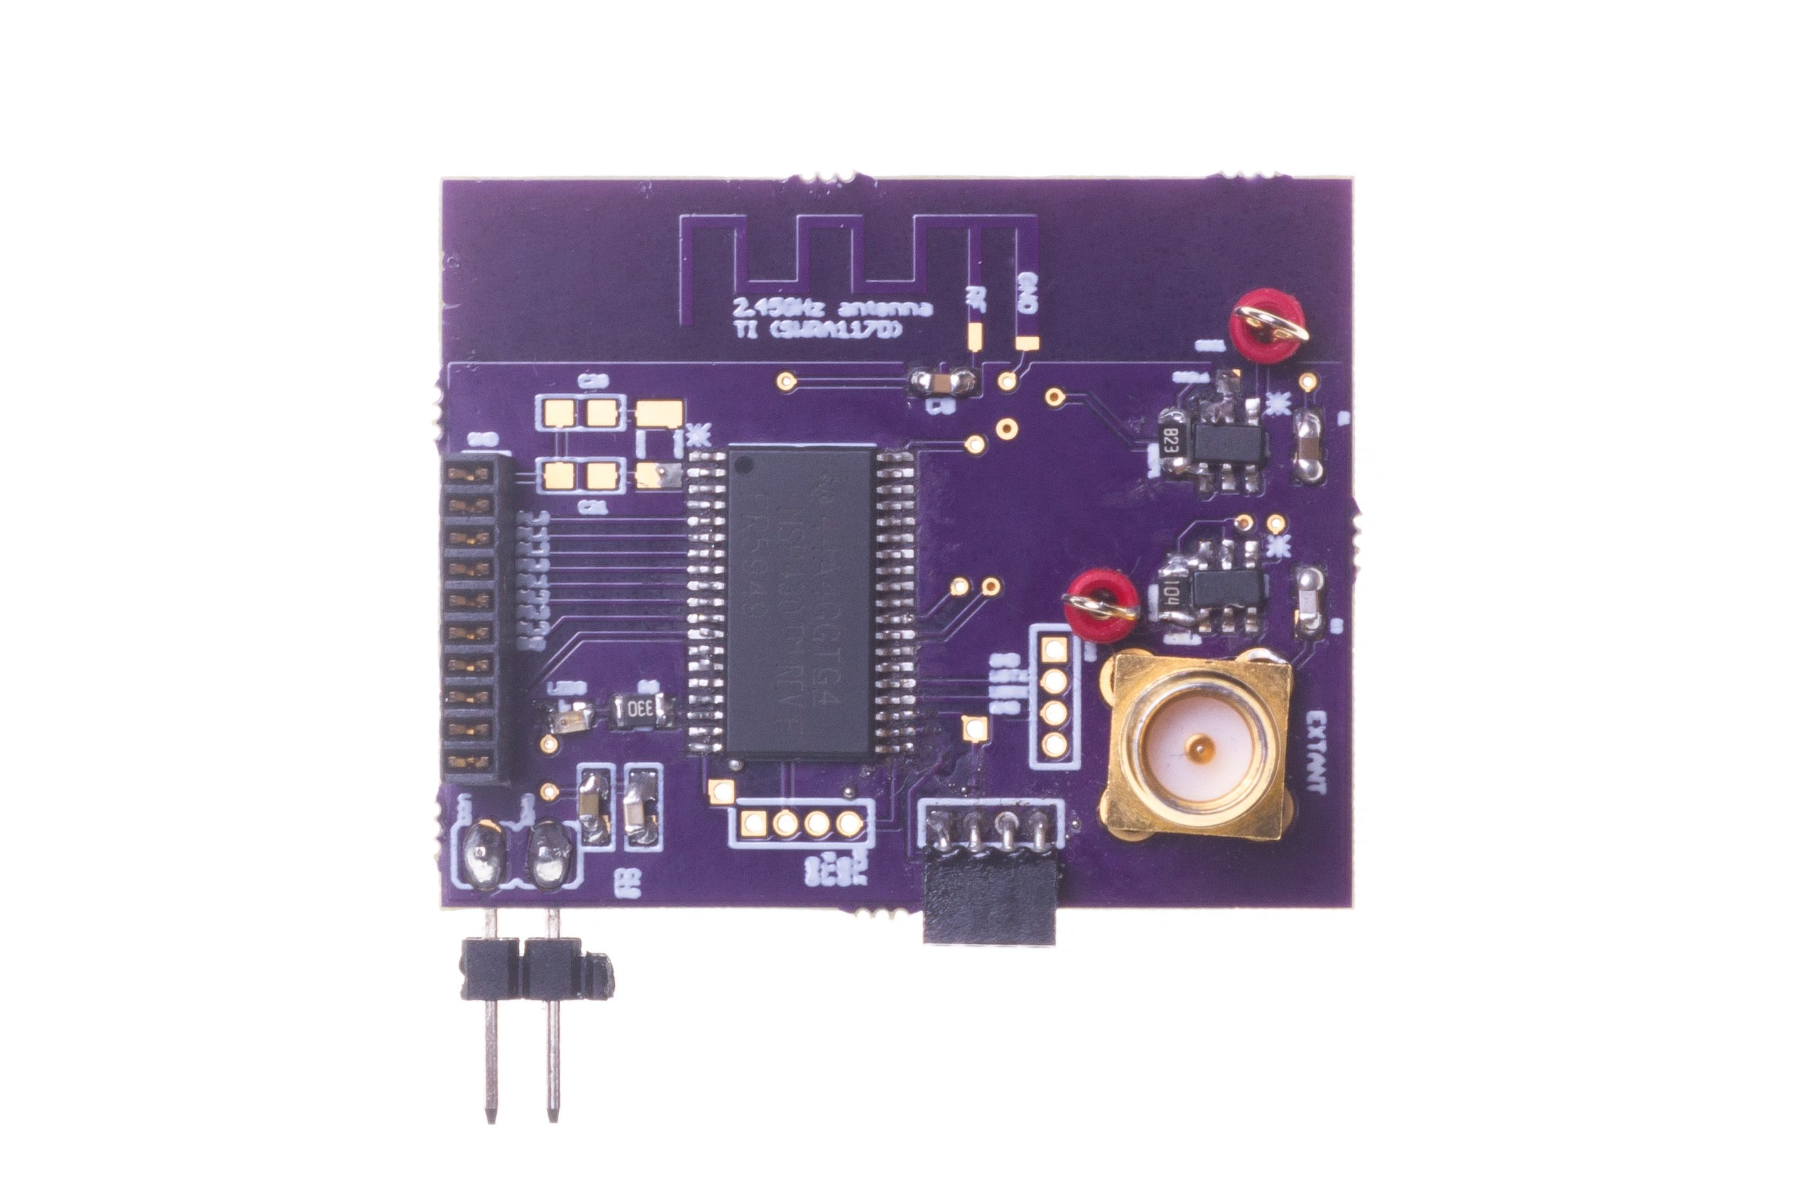
Long range backscatter transmissions using LoRea
LoRea is a long range, low-power, and low-cost backscatter architecture
System Overview
Backscatter Tag Hardware Prototype
(Peak Power of 70 µW)
Varshney et al. ”LoRea: A Backscatter architecture that achieves a long communication range” ACM SENSYS 2017
Notes:
+ Over the past several years, I have designed systems that overcome these critical limitations that have hindered the backscatter systems and have the prevented widespread adoption of the backscatter mechanisms on the Internet of Things devices. One of these systems is LoRea.
+ LoRea was presented at ACM SENSYS, which is a flagship conference in the area of embedded sensor systems. I show the architecture of LoRea on the left-hand figure on the slide. It consists of one or more commodity devices such as a smartphone or Wi-Fi router that provides the necessary carrier signal to support backscatter transmissions, a low-power backscatter tag that I had designed and transmit at a peak power of 70uw, and one or more receiver of backscatter transmissions.
+ The key highlight of LoRea was that it could achieve a significantly larger communication range than existing systems, was designed using off the shelf components and cost (few tens of USDs). Further, the backscatter tag could achieve this capability at orders of magnitude lower energy than commercially available radio transceivers.
+ How did LoRea achieve this capability? We would describe next.

Slide 109
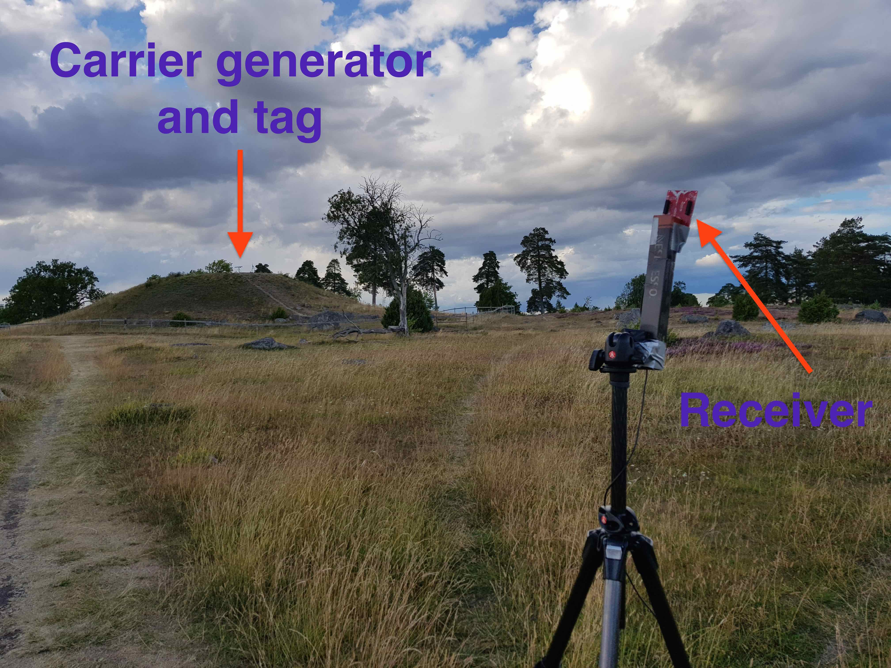
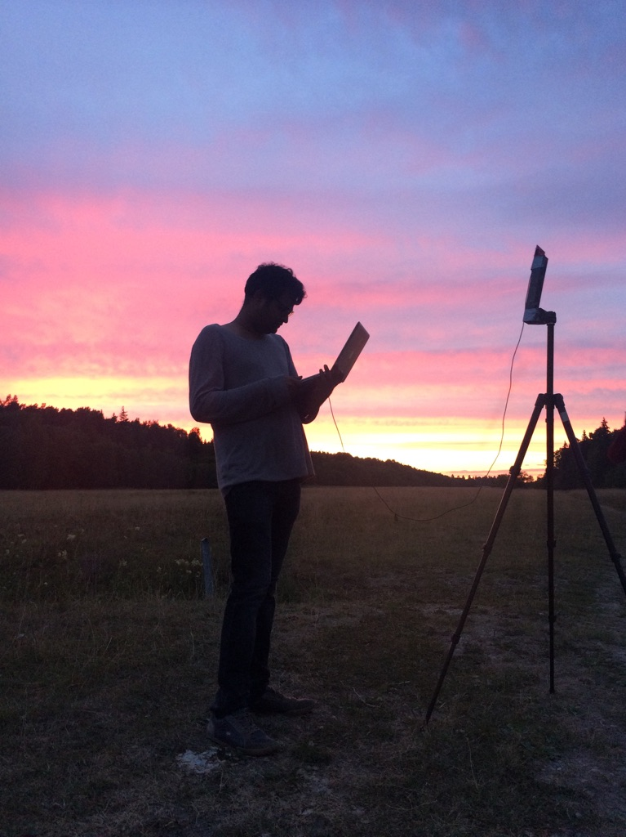

LoRea achieved the highest demonstrated range
Receive up to a distance of 3.4 kilometers from tag
Highest demonstrated range. Outperforms leading labs/universities
Experiment Setup
(On a small hill)
Receiving backscatter transmissions kilometers away from setup
Experiment setup video
Notes:
Hence, to find the maximum range we could achieve with our system, we took the entire setup outside Uppsala to an open space. We kept the backscatter setup on top of a small hill, and investigated the maximum communication range that we could support.
Performing these experiments was significantly challenging, as we would setup experiment in the daytime, and by the time we would finish collecting the link metrics, it would be dawn. We also had to walk significant distances with equipment.
We found that we could communicate up to a distance of 3.4 km while consuming tens of microwatts of power for wireless transmissions at the backscatter tag. Achieving such high communication range was considered challenging or even infeasible with backscatter mechanism, and LoRea helped overturn notion that backscatter is a low range transmission mechanism.

Slide 110
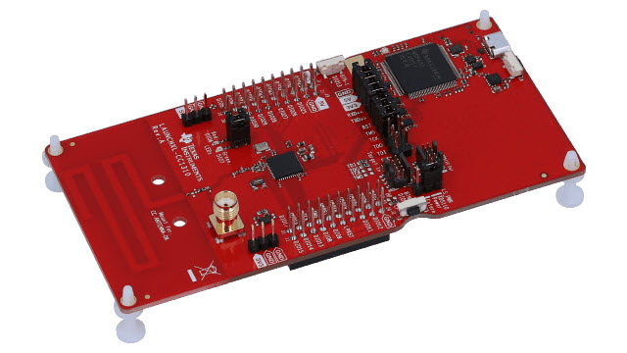
LoRea bridges the energy asymmetry between communication (TX), sensing and processing
Off-the-shelf hardware for transmission and receptions. Tens of USD
Overturn notion that backscatter is a short-range transmission mechanism
Component | Power Consumption
LoRea (Transmissions) | 70 µW (868 MHz)
Conventional Transceiver | Tens to hundreds of mW’s
Microcontroller (Apollo3) | 100s of µW’s
Sensors | Few to tens of µW’s
LoRea transmits at similar power consumption as a sensor
Texas Instruments CC1310 Launchpad: Receiver
Backscatter Tag Hardware Prototype
(Peak Power of 70 µW)
Notes:
+ Thus, with LoRea, we were able to design a backscatter system that was able to overcome the range and cost limitations that had limited all the existing backscatter system, and had hindered the widespread usage of the mechanism on the IoT devices
.
+ In fact, the backscatter tag even though it was designed using off-the-shelf components is orders of magnitude more efficient than commercial transceivers while supporting orders of magnitude lower power consumption.
+ the entire backscatter setup costs just few tens of USDs, which dramatically lowers the cost of infrastructure required to support the backscatter tags and carrier emitter device.

Slide 111
Mitigating interference and improving range
In-band interference from unregulated traffic
Bit spreading over FSK
Forward error correction mechanism at the tag
Spreading mode | Symbol 0 | Symbol 1
1X | 0 | 1
2X | 00 | 11
4X | 1100 | 0011
8X | 00111100 | 11000011
Notes:
Second challenge we identify is managing interference in-band from unregulated traffic operating at the same frequency band. When compared to existing low power long range standard like LoRa,
FSK does not have gains due to coding or error correction mechanisms. We precisely address this particular issue, first we implement a convolution encoder at backscatter tag to introduce error
Correction mechanisms at the backscatter tag. Second, we introduce bitspreading improve resilience against inband inteference.
Bitspreading and error correction mechanisms also help to improve the communication range due to gains achieved due to these coding mehanisms.
In our scheme, we spread each symbol to a known sequence, for example, in spreading mode 8X, we spread symbol 0 to the following sequence 00111100.
Speading also effectively reduces the bitrate of the transmissions further.

Slide 112
Mitigating interference and improving range
Transmission mode | Communication range
FEC + Spreading 8X | 1.35 kilometers
FSK | 1.05 kilometers
Improvement in communication range due to bit spreading. Carrier strength was 24 dBm
Reliability under in-band interference
Notes:
We performed an experiment to observe the improvement in range due to the coding mechanism. We observe, as to some extent, expectedly we are also able to improve the
communication range with these mechanisms. We note, the lower range is due to the lower transmit power of the carrier signal generator used for the experiments.
Next, we performed an experiment to investigate if the spreading helps with improving resilience to inband interference for backscatter transmissions. We set up an interfering node
To transmit at the same frequency as the backscatter tag, and switch between the FSK and DSSS 8X mode. We observe also that spreading helps reduce resilience to interference
For backscatter transmissions.
These mechanisms help to improve reliability of backscatter transmissions which is important for our vision of wide-area network.

Slide 113
Supporting operations of multiple tags
Operations of multiple backscatter tag
Backscatters at same frequency at same time
requires extensive processing to recover from collided transmissions [1,2]
Backscatter not at the same time [TDMA]
Each tag can be allocated separate frequency / channel
Concurrently transmitting tags
Spacing between backscatter transmissions
[1] Pan Hu, Pengyu Zhang, Deepak Ganesan - "Laissez-Faire: Fully asymmetric backscatter communication”- ACM SIGCOMM 2015
[2] Ou, Jiajue, Mo Li, and Yuanqing Zheng - "Come and be served: Parallel decoding for cots rfid tags." – ACM MOBICOM 2015
Notes:
Finally, a crucial ability is to support concurrent transmissions from backscatter tag. We can envision having multiple sensors
Sending information at the same time, which is further compounded by the slow bitrates used for transmissions.
There is large body of work that looks into supporting multiple backscatter transmitters, however, this requires extensive processing at the
Reader to recover collided transmissions or requires tag to not transmit at the same time by using scheme such as TDMA.
We inestead leverage high adjacent challen rejection ability of the commodity transcevers to support operations of multiple
Backscatterr tag.

Slide 114
Learning Objective for Today’s Lecture
Review: last few lecture’s topics
Communication layers
Medium access control
Random access protocol
Controlled access control
Channelization protocol
Spreading and coding
Case Study: LoRea

Slide 115
Wireless Networking
Ambuj Varshney
Assistant Professor, National University of Singapore
Wireless, Embedded Intelligence, Sensing, and Emerging Technologies Group
ambujv@nus.edu.sg

